Slide 1
Liturgy and Prayer
The Liturgical, Sacramental and Prayer Life
Of a Vibrant Parish

Slide 2
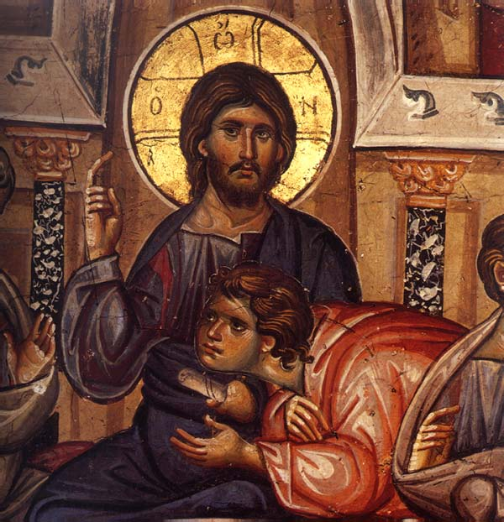
The Eucharist is the Heart
The Most Holy Eucharist is the heart, the well-spring and source from which all prayer flows
It is the well-spring or “beating heart” which gives life to a parish
At the same time, the Eucharist (Risen Christ) is also the goal, the summit and culmination of its life

Slide 3
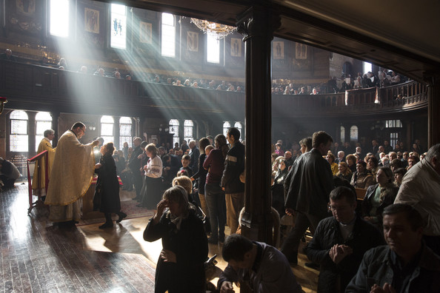
Love for the Eucharist
The life, health and “vibrancy” of a parish community depends upon its attitude, understanding, celebration and devotion to the Eucharist!

Slide 4
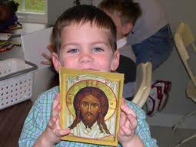
Attitude . . .
If the faithful believe that Divine Liturgy is . . .
The most precious moment in earthly life;
Not an obligation, but a gift;
An encounter with Christ, who longs to meet us and fill us with His grace and love;
Sunday Liturgy is essential – cannot live without it;
Then the parish is vibrant!

Slide 5
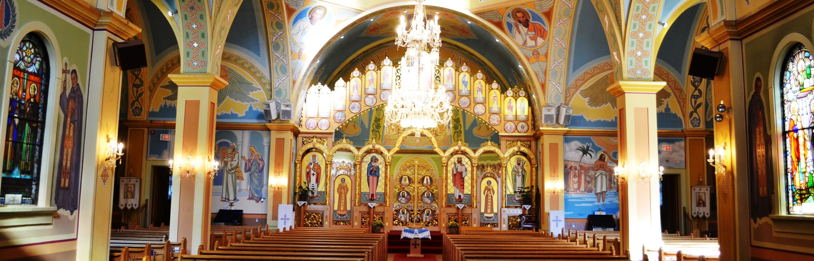
IT’S TRUE! The Divine Liturgy is . . .
The most precious moment of day and our life
A gift – the greatest treasure!
A moment of encounter with the Risen Christ that nourishes us – fills us with grace and love
Essential – can’t live without the Sunday Eucharist (Assembly)
In 303 AD, 49 martyrs of Abitene (present-day Tunisia) proclaimed: “We cannot live without the Sunday Eucharist!” – the preferred a martyr’s death rather than miss their Sunday assembly and Liturgy

Slide 6
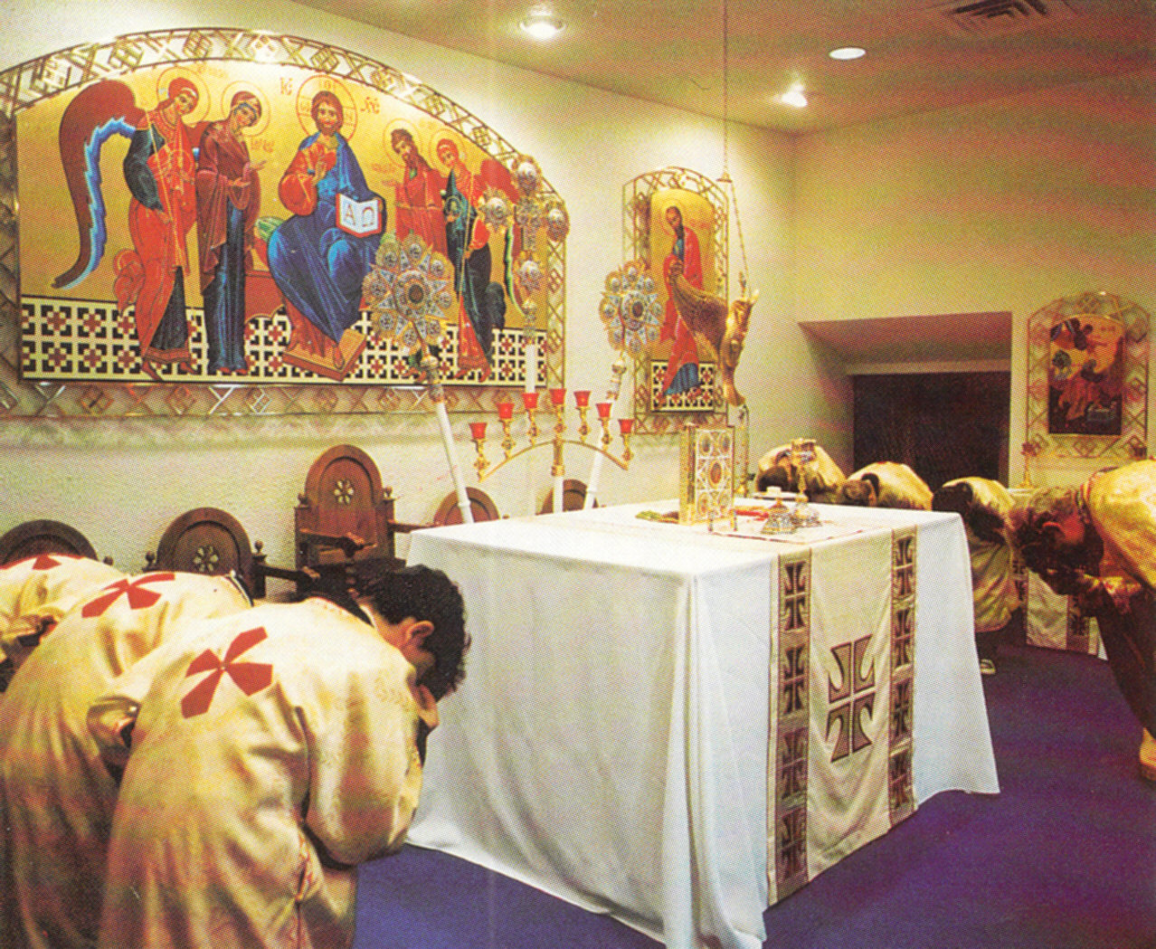
Understanding . . .
If the faithful understand:
The meaning of each word in every prayer and petition;
The parts and structure of the Divine Liturgy;
The symbolism behind each liturgical action and gesture;
What is happening spiritually and invisibly;
The Liturgy is not entertainment, but work; it requires personal effort
The parish is vibrant!

Slide 7
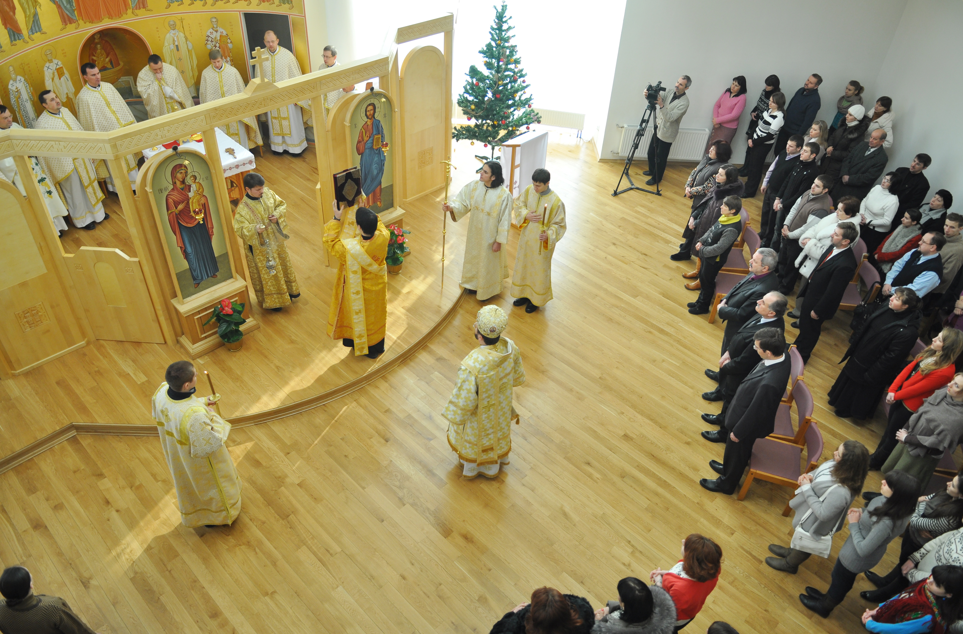
Attentive Celebration . . .
The Divine Liturgy requires:
Preparation – faithful, cantors, reader, servers, homilists, priests
Reverence – everything is done with love
Attentive Prayer – speaking sincerely from the heart and listen attentively
Active Participation – body, soul, and spirit
If the community struggles to make the Sunday Liturgy prayerful, reverent, beautiful and meaningful – the parish is vibrant!

Slide 8
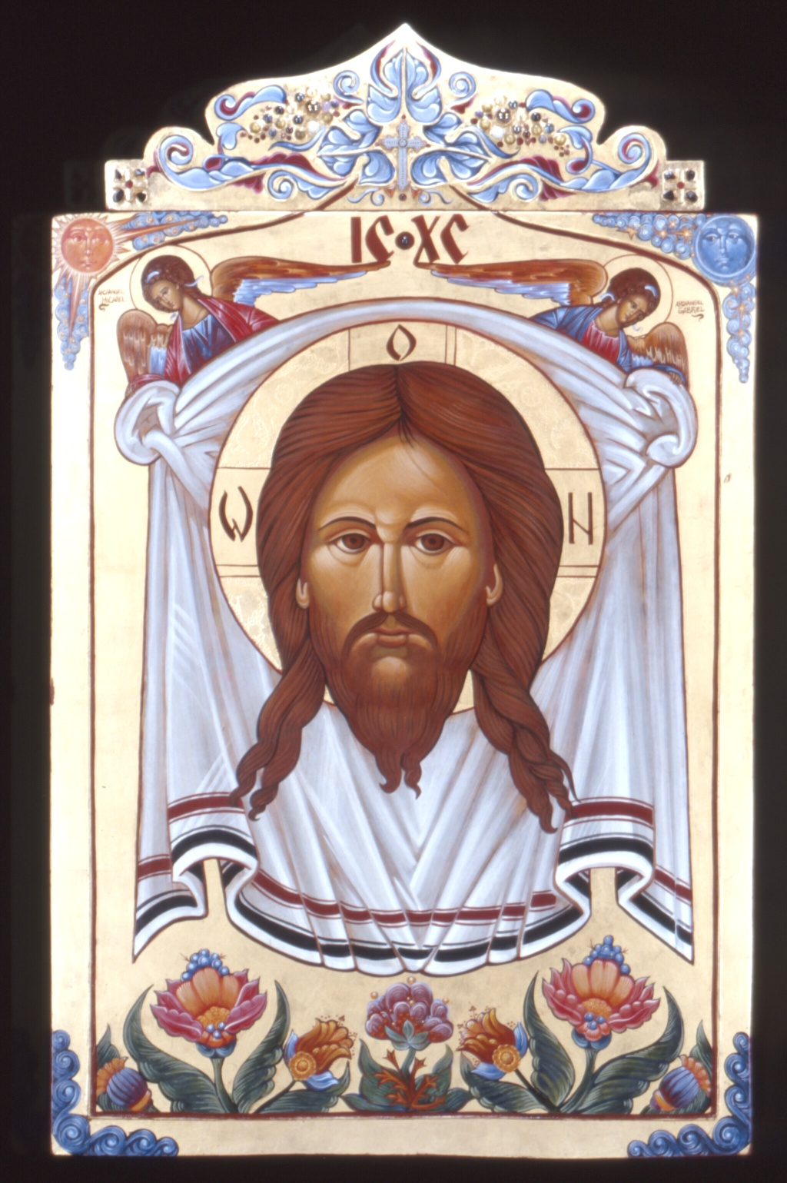
Devotion . . .
Devotion is simply a deep love for Jesus – I love Jesus!
At the Divine Liturgy, there are two moments of great intimacy – the Proclamation of the Word; the reception of the Holy Gifts
If the faithful struggle to receive Jesus at these two moments with renewed devotion and fervent hearts (not cold, not lukewarm)
the parish is vibrant!

Slide 9

Concentric Circles of Prayer
From the Eucharist flow concentric circles of liturgical, sacramental, FAMILY AND PERSONAL prayer

Slide 10
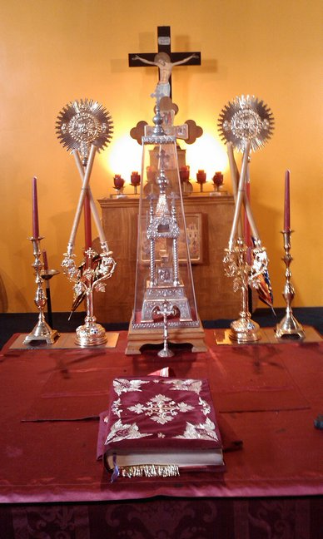
Liturgical Prayer
The first concentric circle is LITURGICAL PRAYER (Communal)
If encounter with Christ is strong at the Eucharist – this gives birth to the desire to gather in prayer on other occasions
LITURGICAL PRAYER: Matins, Hours, Vespers, Compline
DEVOTIONAL PRAYER: Molebens, Akathist Hymns, Rosary, etc.
Liturgy in turn prepares us for a stronger encounter with Christ in the Divine Liturgy (Eucharist)

Slide 11
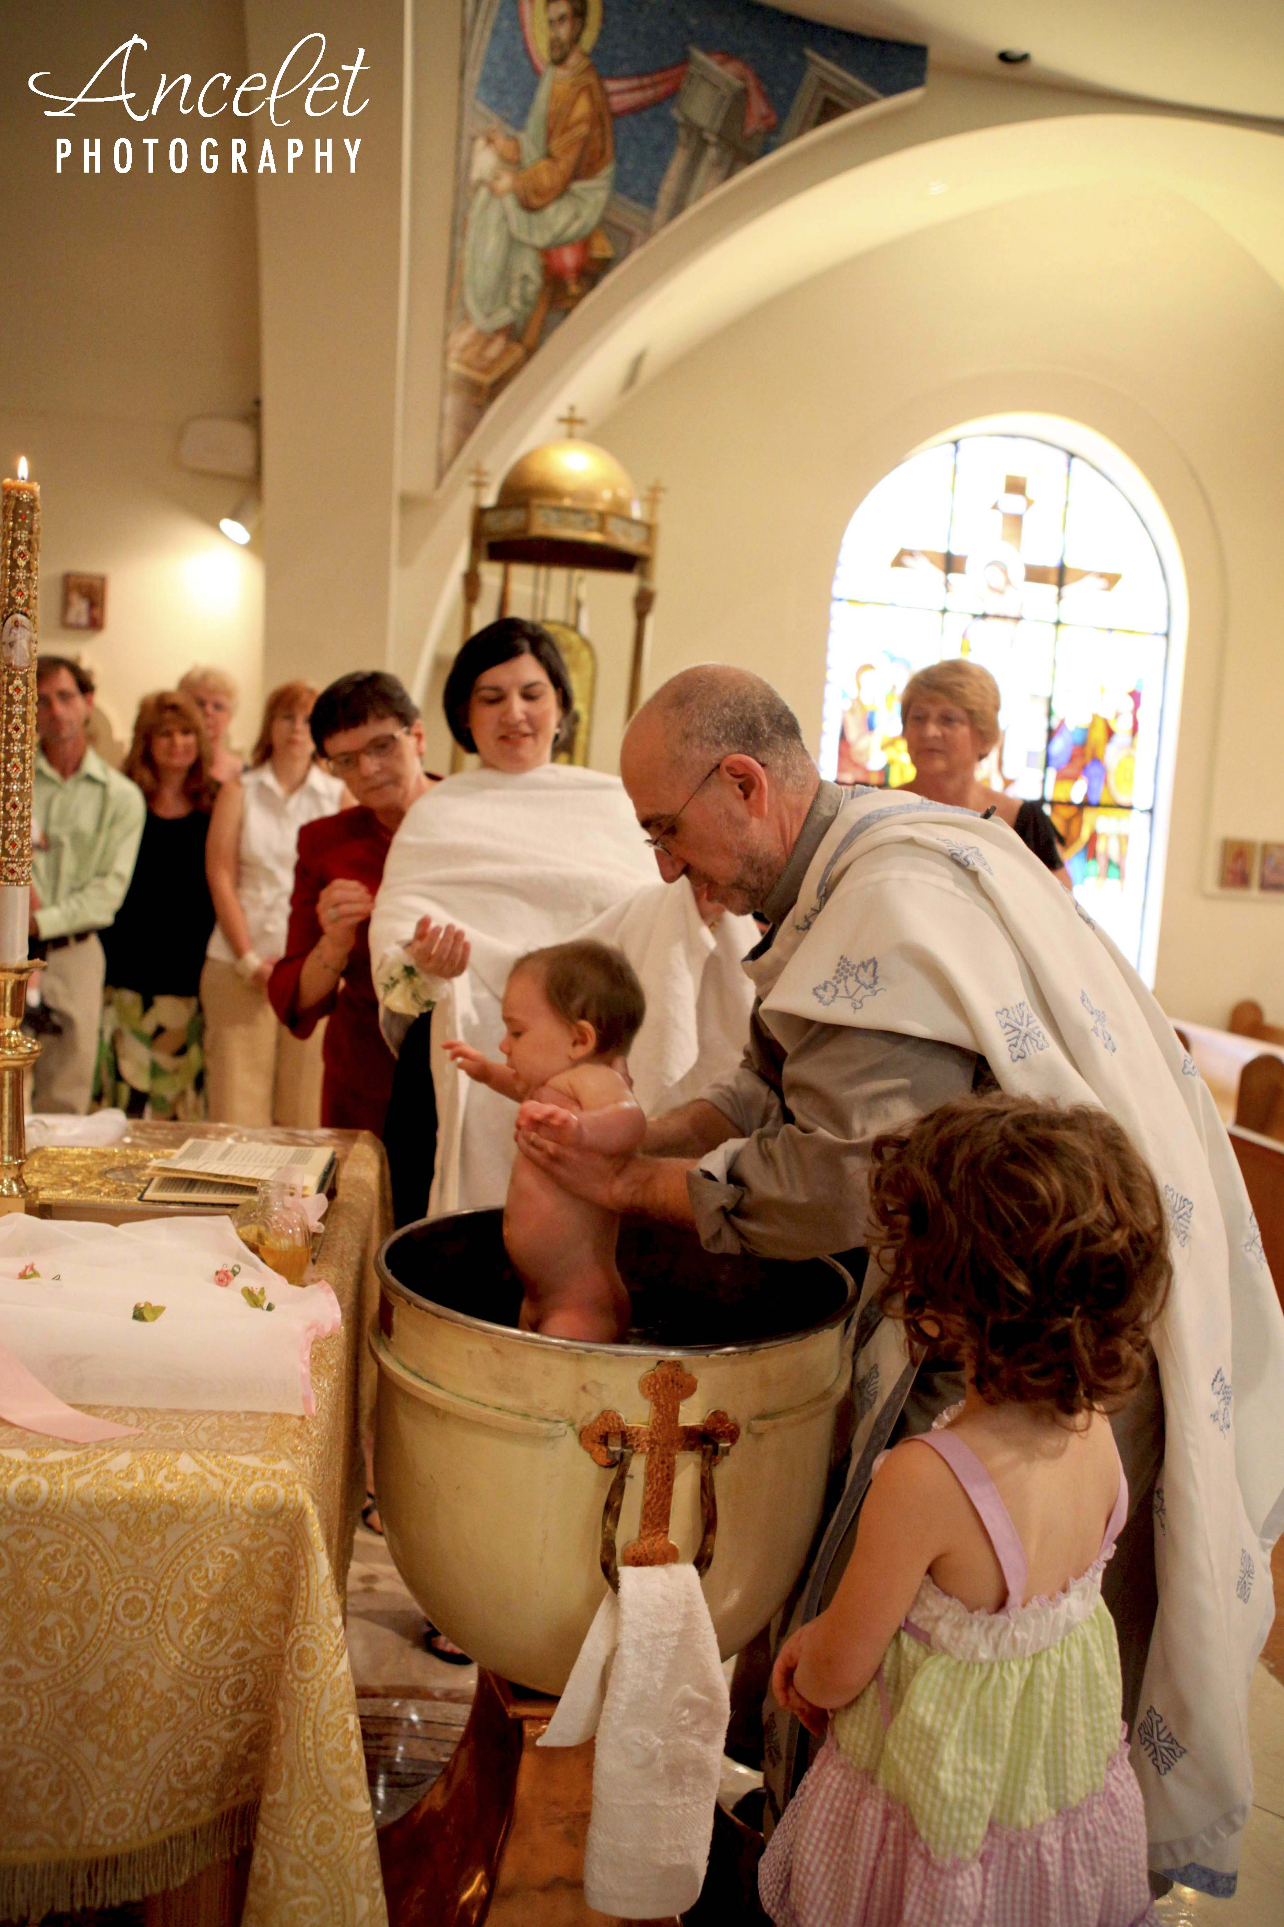
Holy Mysteries
The second concentric circle is the celebration of HOLY MYSTERIES (SACRAMENTS), Funerals & Blessings
The encounter with Christ in the Divine Liturgy – gives rise to the need for Baptism, Chrismation, Penance, Christian Marriage and Holy Orders
How the Eucharist is celebrated – affects how the Holy Mysteries are celebrated (also experience of Christ)
Encounter with Christ in the Holy Mysteries prepares us for the encounter with Christ in the Divine Liturgy

Slide 12
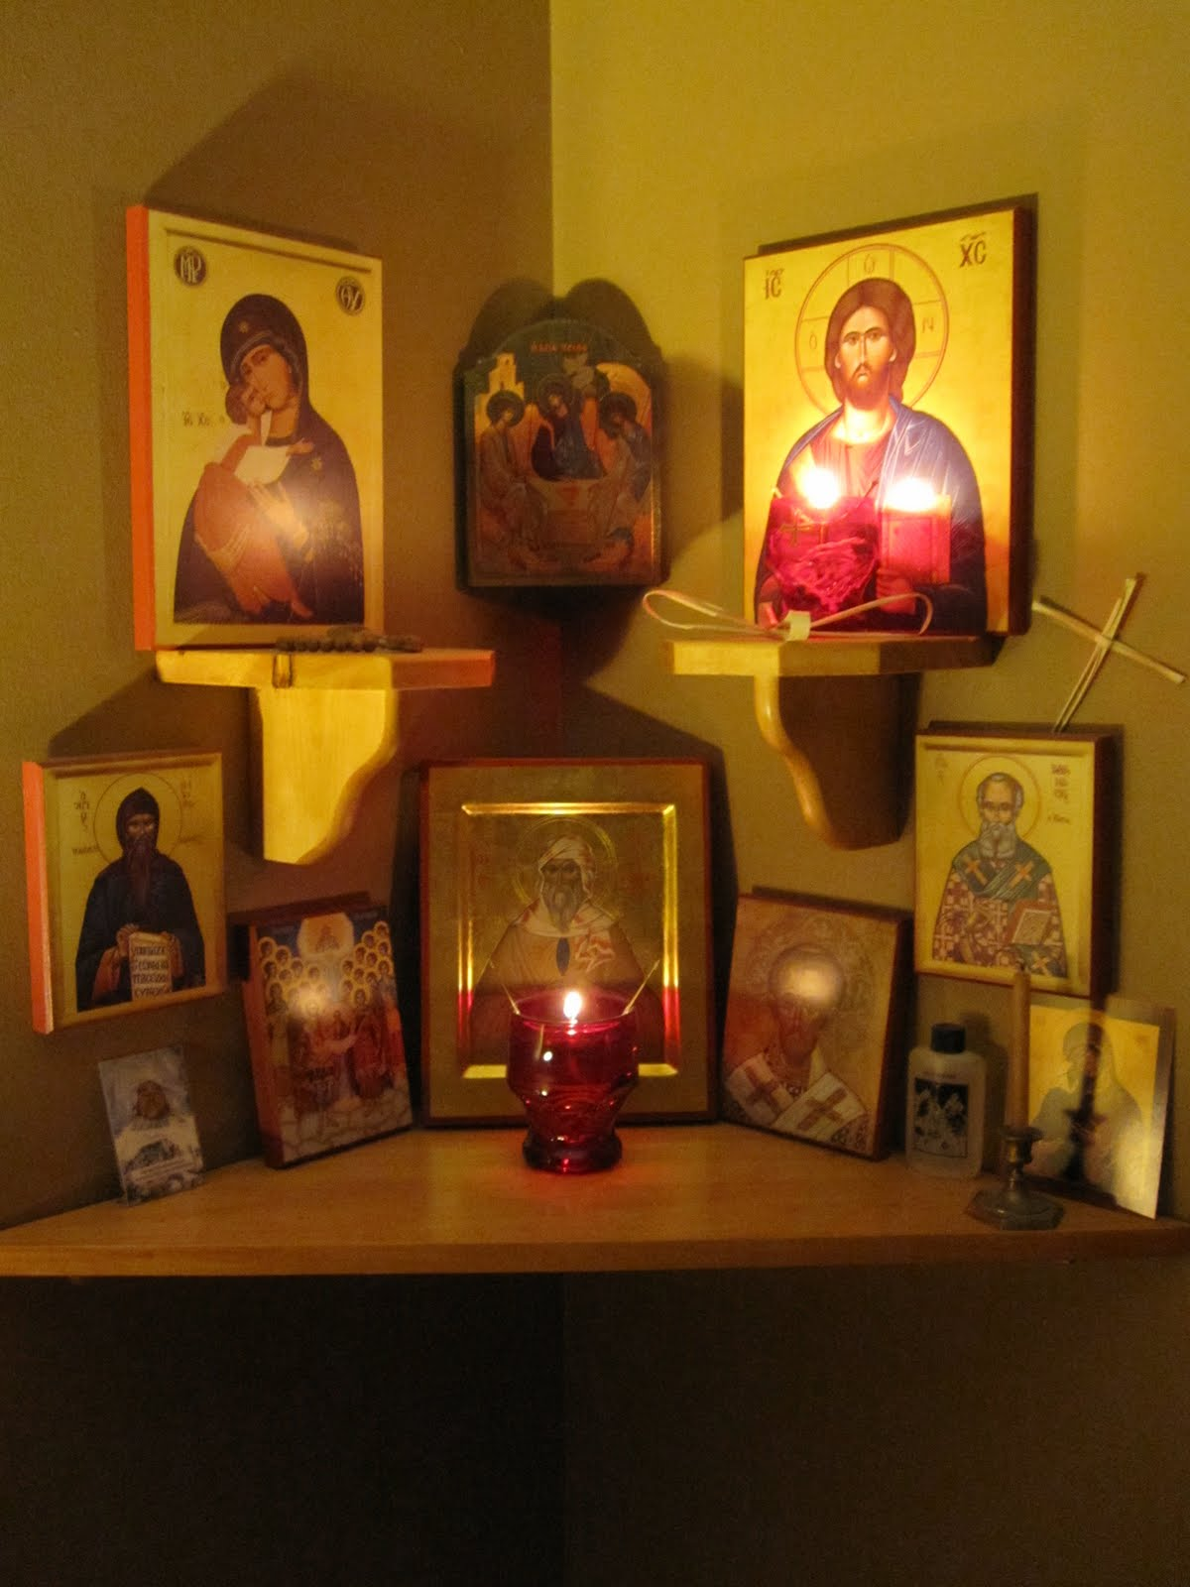
Family Prayer
The third concentric circle is FAMILY PRAYER (also communal)
If encounter with Christ is strong at the Eucharist – this gives birth to the desire to gather in prayer at home as a family
The Icon Corner becomes an extension of the Church into the home (domestic church)
Family Prayer in turn prepares us for a stronger encounter with Christ in the Divine Liturgy (Eucharist)
The home is to be a school of prayer

Slide 13
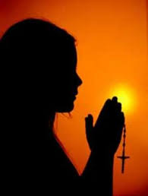
Personal Prayer
The fourth concentric circle is PERSONAL PRAYER
If encounter with Christ is strong at the Eucharist – this gives birth to the desire to spend time alone with Jesus in prayer
Personal daily prayer in turn prepares us for a stronger encounter with Christ in the Divine Liturgy (Eucharist)
Our life is to be transformed into a prayerful state.

Slide 14
Unceasing Prayer
Christ teaches us “to pray always and not to lose heart” (Lk 18:1; Lk 11:5-8)
Apostle Paul in turn calls us to “pray without ceasing” (1 Thess 5:17)
UGCC Catechism: “This life is [to be] transformed into a prayerful state, a constant readiness of heart. The Christian should ceaselessly cultivate this state . . . To consecrate the entire day to the Lord” (PAR 668)

Slide 15
One Divine Liturgy (Eucharist)
The One Divine Liturgy takes place unceasingly in Heaven – the celebration of the Divine Liturgy on earth unites with the unceasing worship that takes place in Heaven
“Around the throne, and each side of the throne, are the four living creatures . . . Day and night without ceasing they sing, ‘Holy, holy holy, the Lord God Almighty . . .” (Rev 4:6-11)
“Then I looked, and I heard the voice of many angels surrounding the throne . . . They numbered myriads and myriads and thousands of thousands, singing with full voice, ‘Worthy is the Lamb that was slaughtered . . . To the one seated on the throne and the Lamb be blessing and honour, glory and might forever and ever!” (Rev 5:11-14)

